Slide 1
Other Cloud Building Blocks

Slide 2
Agenda
Containers
Cognitive services
Bot Framework (Preview)
Skype for Business SDK (Preview)

Slide 3
Introduction to Containers
Notes:
Not new – have existed for decades
Method of slicing up an OS to run multiple applications
Kernel is shared between host and containers
Build with successive “layers” with images
Shifting how applications are built and deployed

Slide 4
Monoliths to microservices
Small, “single role” services
Individually built and deployed. Version and update independently
Integrate using published API calls for overall application functionality
Fine-grained, loosely coupled application
Monolithic application approach
Microservices application approach
App 1
App 1
App 2
1
3
2
4

Slide 5
VM to Container Comparison
Virtual Machines
Containers
Application A
Application B
Application A
Application B
Guest OS
Guest OS
Hypervisor
Host OS w/Container Support
Physical Server
Physical Server
Notes:
Ignite - brk3147
https://techcommunity.microsoft.com/t5/Microsoft-Ignite-Content/BRK3147-Accelerate-application-delivery-with-Docker-Containers/m-p/10719/highlight/true#M698
VMs:
Dependencies: Each virtualized app includes the app itself, required binaries and libraries and a guest OS, which may consist of multiple GB of data.
Independent OS: Each VM can have a different OS from other VMs, along with a different OS to the host itself.
Flexible: VMs can be migrated to other hosts to balance resource usage and for host maintenance, without downtime.
Secure: High levels of resource and security isolation for key virtualized workloads.
Containers:
Dependencies: Every application has its own dependencies which include both software (services, libraries) and hardware (CPU, memory, storage).
Virtualization: Container engine is a lightweight virtualization mechanism which isolates these dependencies per each application by packaging them into virtual containers.
Shared host OS: Processes in containers are isolated from other containers in user space, but share the kernel with the host and other containers.
Flexible: Differences in underlying OS and infrastructure are abstracted away, streamlining ‘deploy anywhere’ approach.
Fast: Containers can be created almost instantly, enabling rapid scale-up and scale-down in response to changes in demand.

Slide 6

Container workflow
Developers update, iterate, and deploy updated containers
Physical/Virtual Servers
2
3
Operations collaborates with developers to provide app metrics and insights
Developers build and test apps in containers, using development environment
Operations automates deployment and monitors deployed apps from central repository
1
2
Containers pushed to central repository
Notes:
Accelerate application development and deployment
Increase consistency between environments
Better utilize resources with increased density
Support microservice architectures
Leverage vibrant community of images and tooling

Slide 7




Docker Vocabulary 101
Docker Image
The basis of a Docker container. Represents a full application
Docker Container
The standard unit in which the application service resides and executes
Docker Engine
Creates, ships and runs Docker containers deployable on a physical or virtual, host locally, in a datacenter or cloud service provider
Registry Service (Docker Hub or Docker Trusted Registry)
Cloud or server based storage and distribution service for your images

Slide 8
Basic Docker Commands
$ docker pull nginx
$ docker images $ docker run –d –p INTERNALPORT:EXTERNALPORT –-name CONTAINERNAME ACCOUNTNAME/IMAGENAME:TAG (or latest)
$ docker ps $ docker stop CONTAINERNAME (or <container id>)
$ docker rm CONTAINERNAME (or <container id>)
$ docker rmi ACCOUNTNAME/IMAGENAME:TAG
$ docker build –t ACCOUNTNAME/IMAGENAME:TAG .
$ docker push ACCOUNTNAME/IMAGENAME:TAG

Slide 9
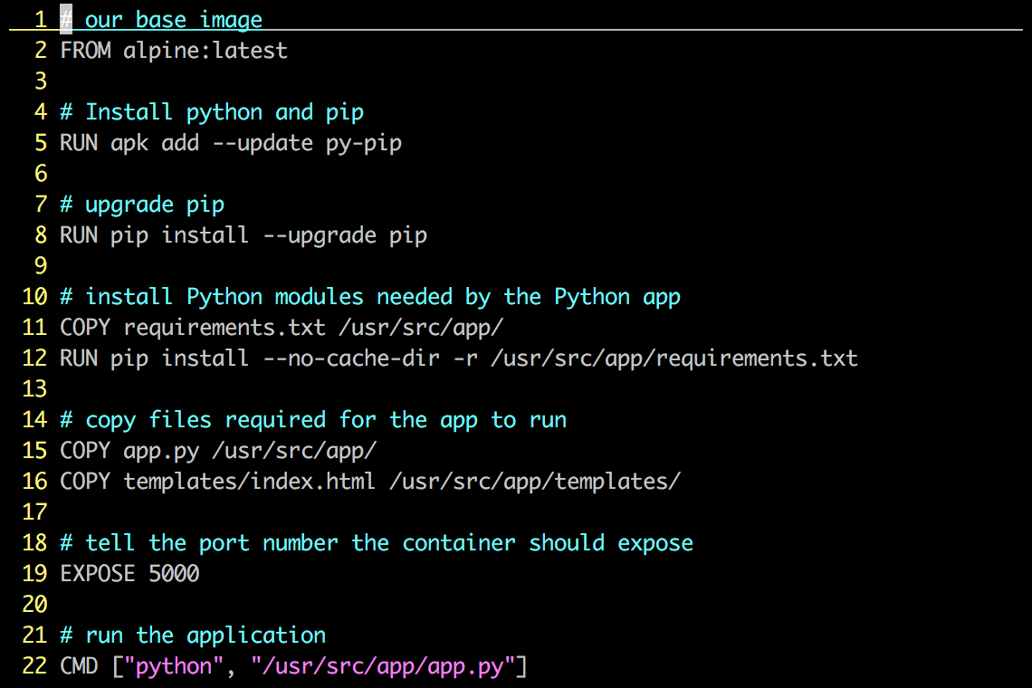
Dockerfile – Linux Example
Instructions on how to build a Docker image
Looks very similar to “native” commands
Important to optimize your Dockerfile

Slide 10
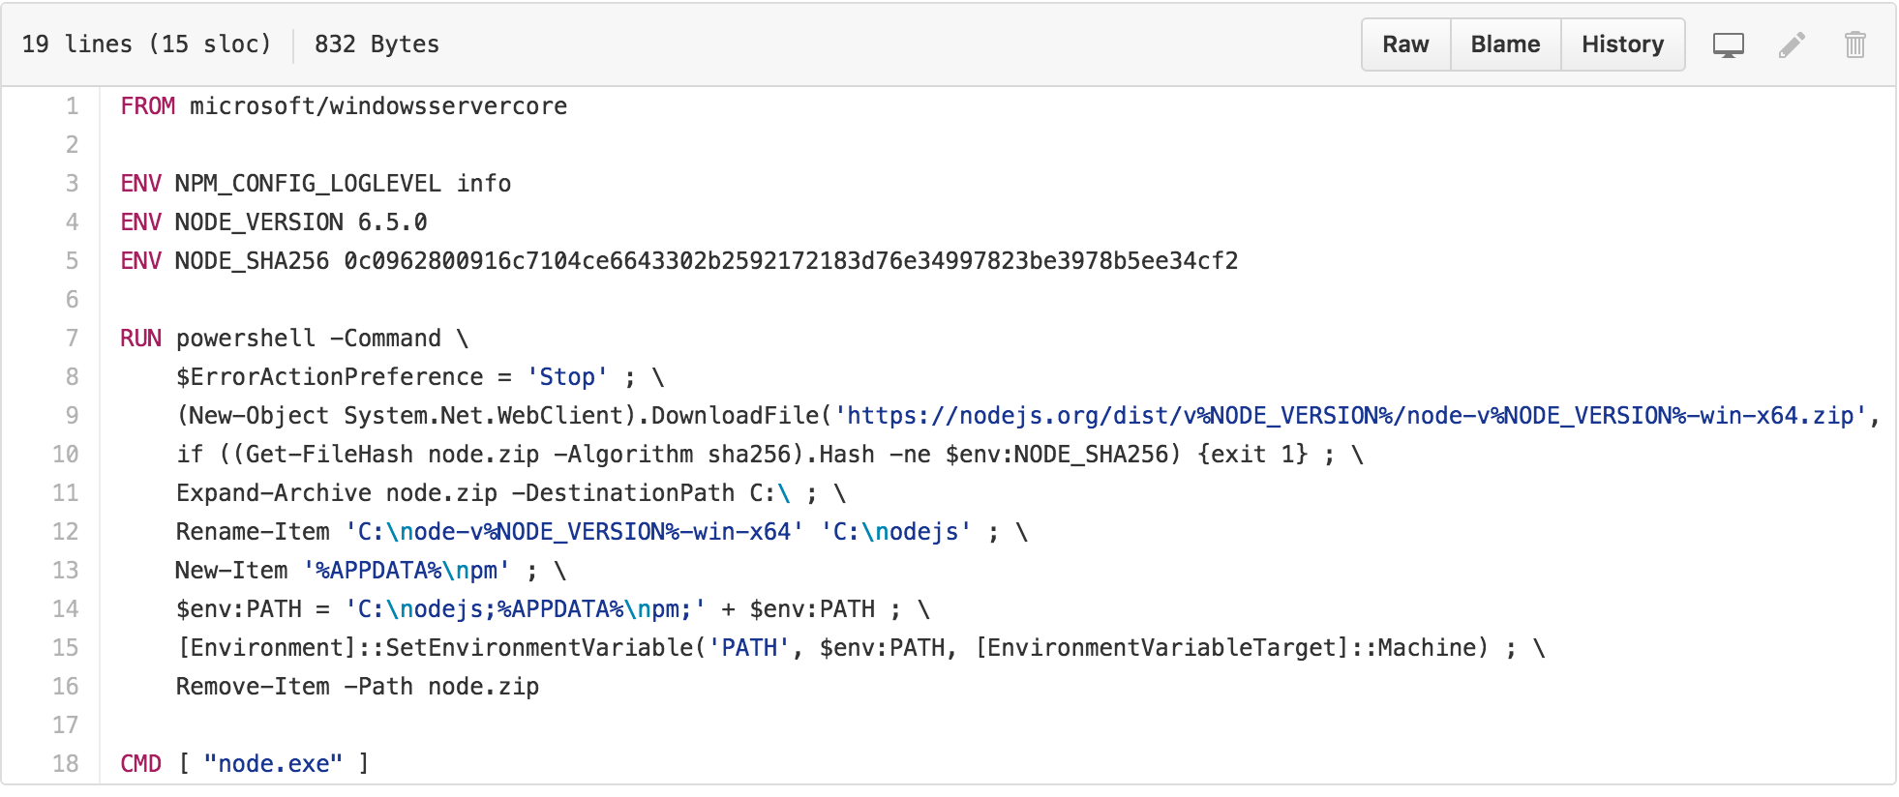
Dockerfile – Windows Example

Slide 11
Demo
Container Hello World
Notes:
Show stuff.
Ross Gardler’s scale up 25 web servers fast.
Pull from registry, Run

Slide 12
Windows Server Containers
Container capabilities built directly into Windows Server
Deploy and manage containers with PowerShell or Docker
Deep integrations with Visual Studio
Distributable via Docker Hub

Slide 13
Hyper-V Containers
Hyper-V Container
Hyper-V Container
Higher level of isolation and security for containers
Useful for sensitive workloads
Same image, same commands, same APIs
Does not share kernel
Built on Hyper-V technology
Application A
Application B
Windows Guest OS
Windows Guest OS
Hypervisor
Physical Server

Slide 14
Cognitive

Slide 15

Microsoft Cognitive Services Give your apps a human side
Vision
From faces to feelings, allow your apps to understand images and video
Speech
Hear and speak to your users by filtering noise, identifying speakers, and understanding intent
Language
Process text and learn how to recognize what users want
Knowledge
Tap into rich knowledge amassed from the web, academia, or your own data
Search
Access billions of web pages, images, videos, and news with the power of Bing APIs

Slide 16
Cognitive Services Demos
Notes:
Pick a few
Go to https://www.microsoft.com/cognitive-services/en-us/
https://text-analytics-demo.azurewebsites.net/
https://www.microsoft.com/cognitive-services/en-us/emotion-api
https://www.microsoft.com/cognitive-services/en-us/face-api
https://www.mymoustache.net/
http://www.how-old.net
https://www.twinsornot.net/

Slide 17
Bot Framework

Slide 18
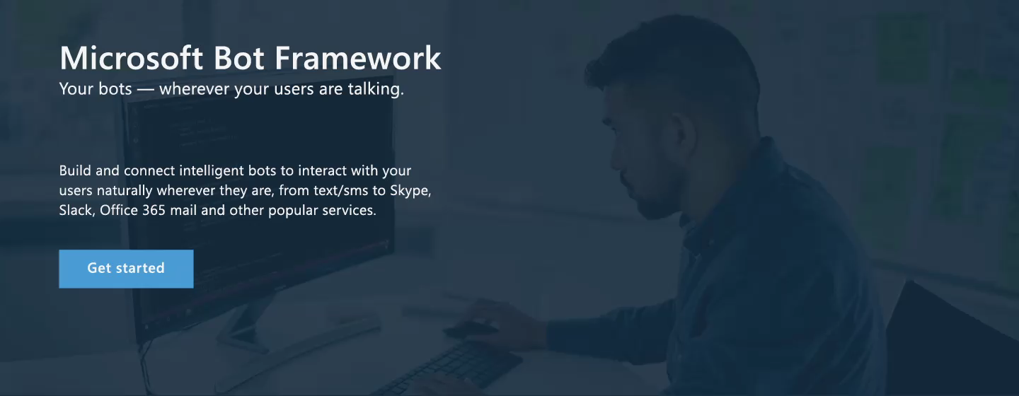
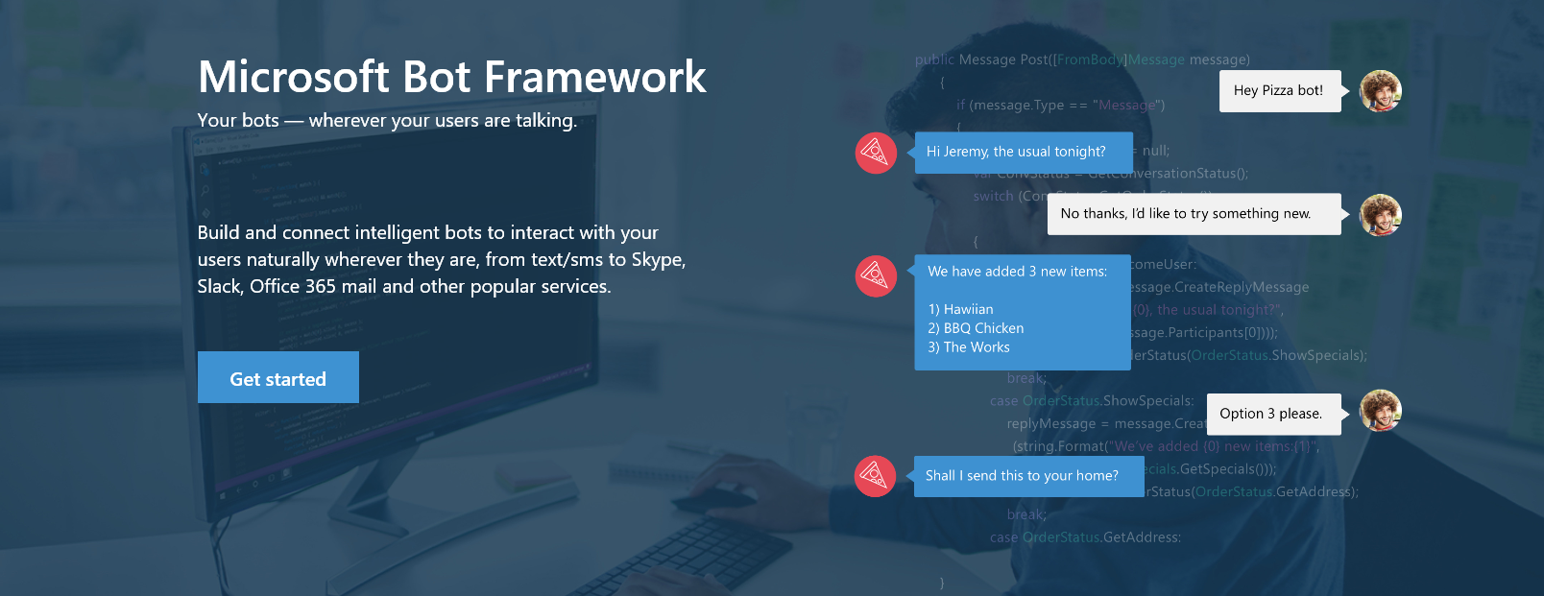

www.botframework.com

Slide 19

Bot Framework Components
Your Bot Framework Bot
Developer Portal
Bot Builder SDKs
Bot Directory
Connect your bot(s) to text/sms, Office 365 mail, Skype, Slack, and other services.
Build great dialogs within your Node.js- or C#-based bot
COMING SOON - Try, use, and add published bots to the world’s top conversation experiences
Register, connect, publish and manage your bot through the bot dashboard
Automatic card normalization across channels
Skype channel auto-configured
Embeddable web chat control
Host your bot in your app using DirectLine API
Fast, secure message routing
Diagnostic tools
Open source SDK on Github
From simple built-in prompts and command dialogs to simple to use yet sophisticated ‘FormFlow’ dialogs
Support for rich attachments (image, card, video, doc etc); support for calling Skyoe
Online/offline emulator
Add smarts with Cognitive Services
Public directory of bots registered and approved with Bot Framework
Users can try your bot from the directory via the web chat control
Users can discover and add your bot to the channels on which it is configured

Slide 20
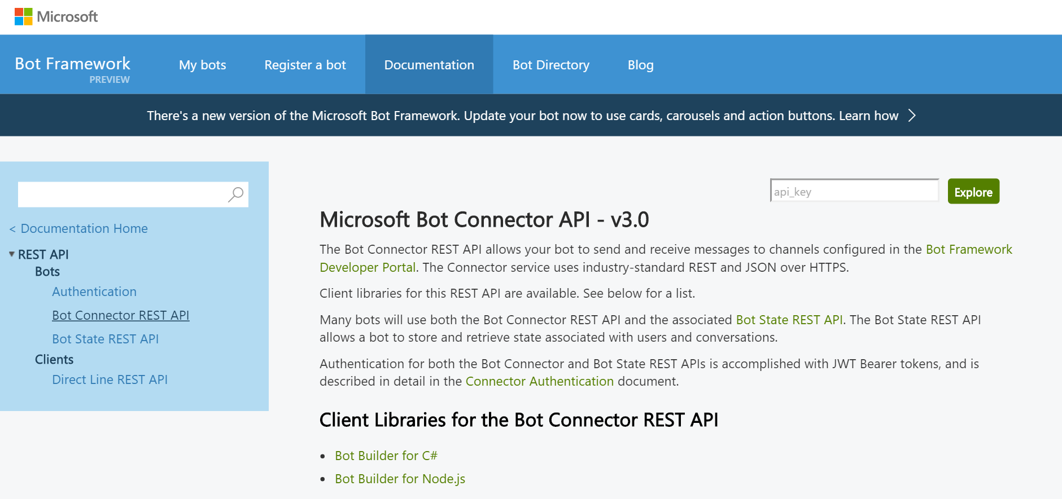
Bot Builder SDK
.NET framework with C# or Node.js
REST and REST State APIs
Manages the conversation state
Bot
Logic
Bot Builder SDK
Web
Service
LUIS

Slide 21
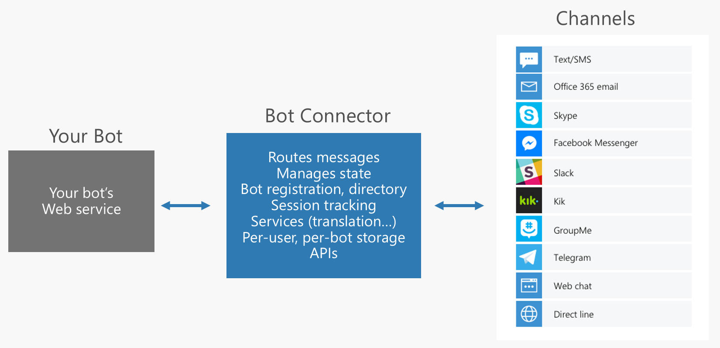
Supported Channels

Slide 22
Demo Bots
Notes:
Go to the Bot site
https://bots.botframework.com/
Demo
https://bots.botframework.com/bot?id=MorphiBot

Slide 23
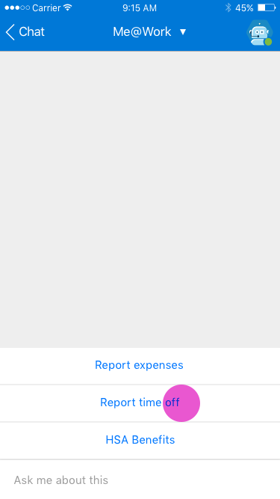
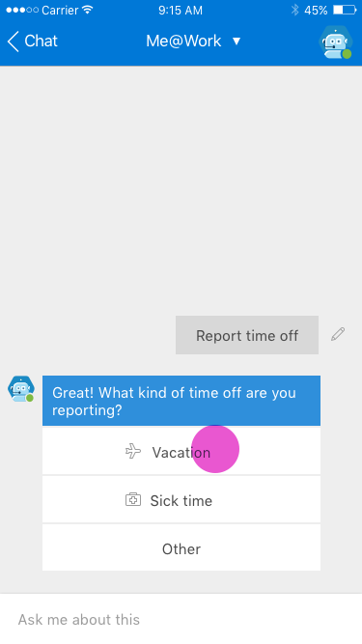
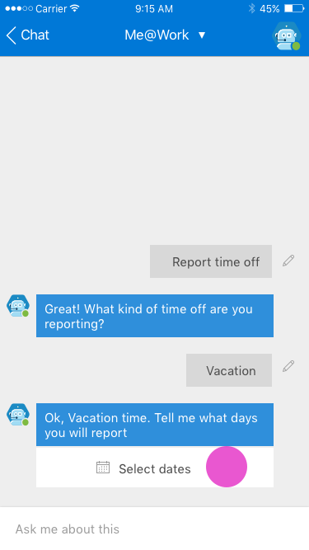
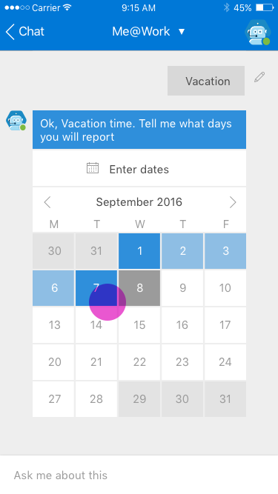
My Org Bot – Vacation Reporting

Slide 24
Getting Started with Azure Bot www.botframework.com github.com/Microsoft/BotBuilder

Slide 25
Office APIs

Slide 26
Skype for Business

Slide 27

Engage users through conversations
Your Apps & Services
Connect your service to conversations
Embed conversations in your app
Engage & Win users

Slide 28
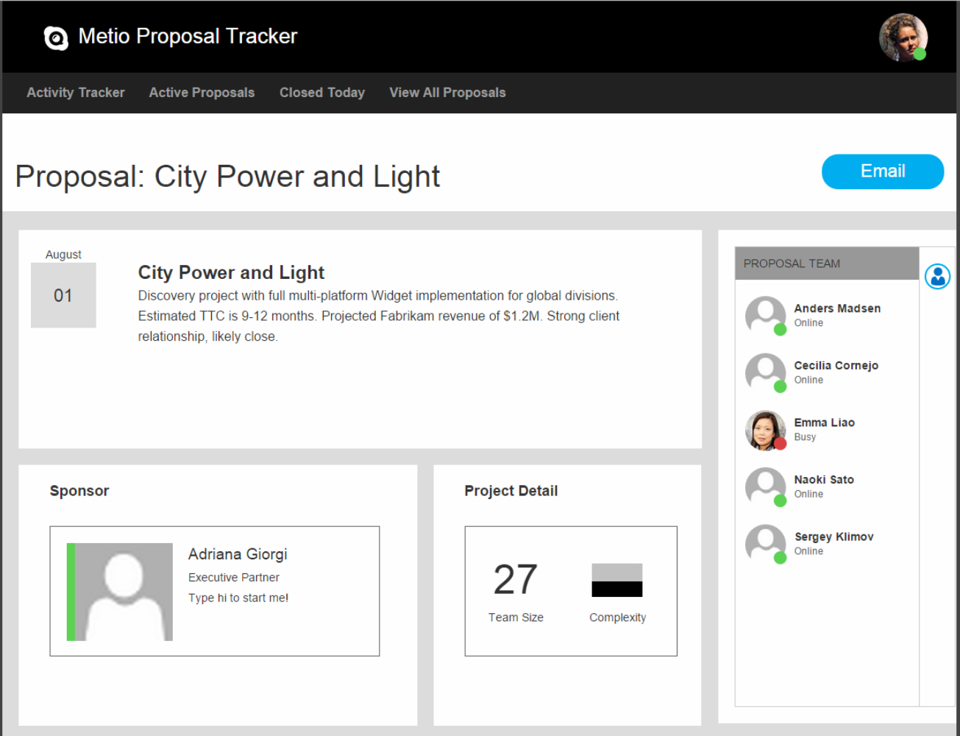
Line of Business App Integration
Bring awareness and instant engagement to the people-centric web and mobile experiences they already use every day:
Approval workflows
Help Desk and Chat Support
“Meet Now” with virtual teams
CRM and Sales teams
and many more…

Slide 29
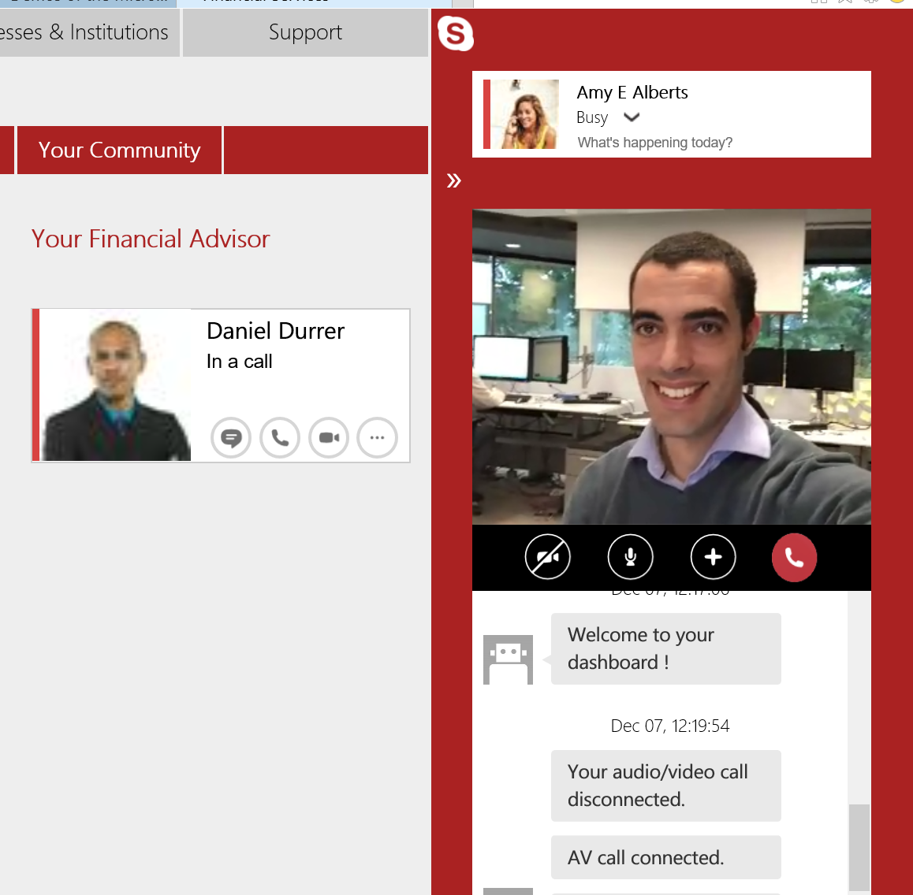
Remote Advisor: Client → Advisor
Clients get integrated, personal, audio/video engagement with web and mobile experiences:
Wealth management
Telehealth Virtual Office Visit
Ad-hoc advisor engagement
Remote interviews

Slide 30

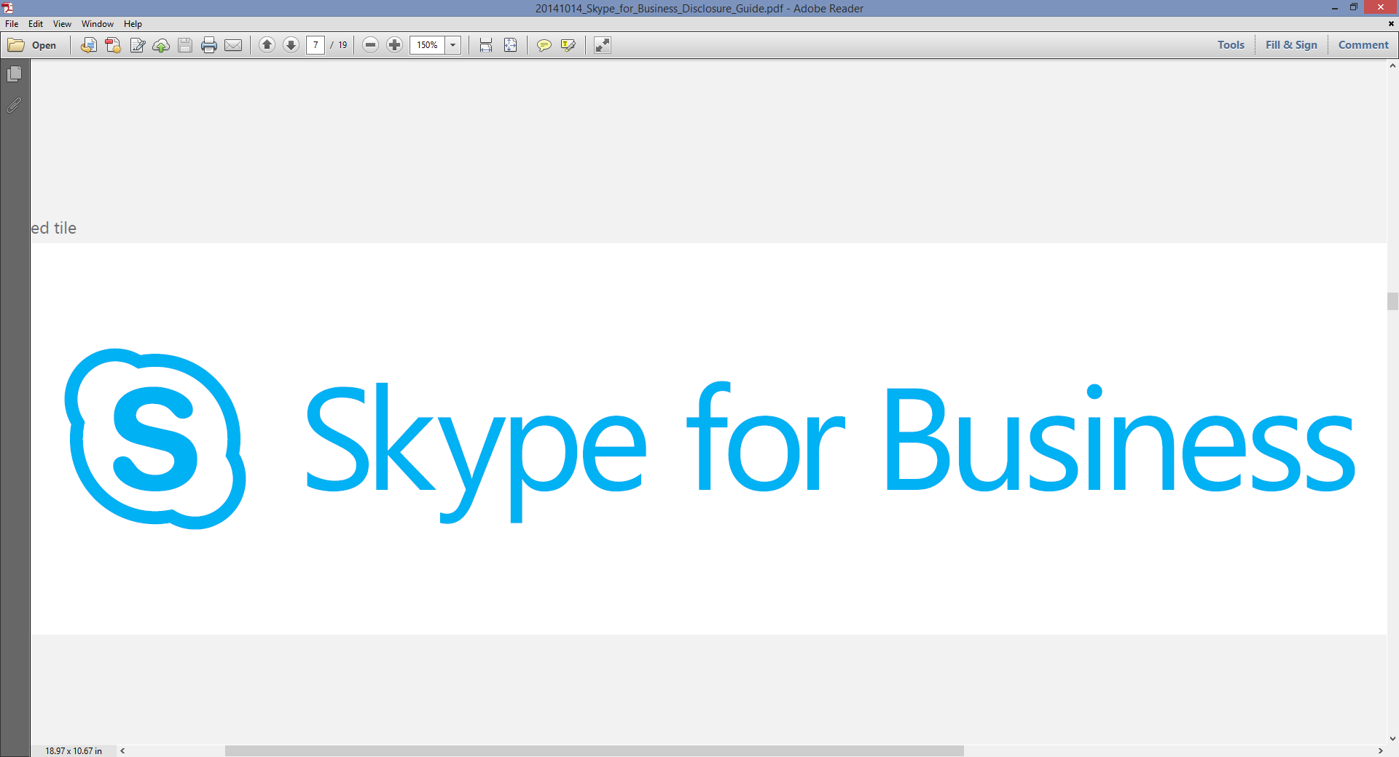
Remote Advisor: Mobility
Customers
Providers
Easy, seamless engagement
Download single provider app from store
Single Sign-on using provider credentials
Collab in app context
Seamless voice + video
Voice + Video
Shared context with customer
Integrated agent experience

Slide 31
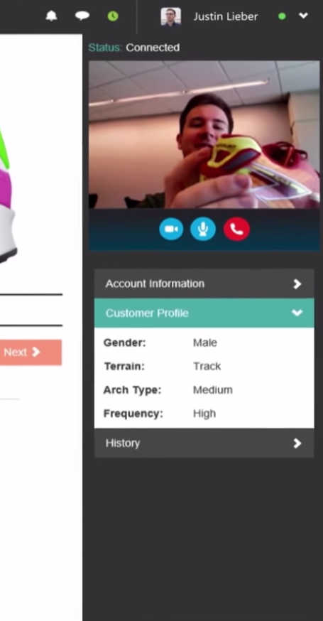
Remote Advisor: Agent Experience
Agents engage using experiences they are comfortable with:
Dedicated advisor experience with client account context and integrated communications
Integration with popular CRM and Service Management solutions
Direct contact via Skype for Business clients for SMEs and ad-hoc consult

Slide 32
Skype Developer Platform Design
Your web app
Your mobile/tablet app
Your service / bot
Skype Web SDK
Skype for Business
App SDK (Preview)
Trusted Application SDK
Bot Framework
JavaScript
iOS (Objective C), Android (Java)
Object Model
Media
Object Model
Media
Client
Service / Server
Skype Developer Platform
User API / UCWA
Trusted Application API / UCMA
Object Model
Skype Capabilities

Slide 33
References
https://msdn.microsoft.com/en-us/skype/websdk/skypewebsdk
https://msdn.microsoft.com/en-us/skype/appsdk/skypeappsdk
http://developer.skype.com
A Technical Deep Dive into Building Web Apps with the Skype Web SDK (Ignite 2015)
Engage and Win Users with Your Apps Through Intelligent Conversations (Build 2016)
Relation Sessions
Drive real-world success with Skype for Business platform solutions https://myignite.microsoft.com/sessions/2631
Dive deep on the new Trusted Application API for Skype for Business Online https://myignite.microsoft.com/sessions/2629
Build native cloud apps for Skype for Business: Skype Developer platform overview
https://myignite.microsoft.com/sessions/2630

Slide 34
OneNote API

Slide 35
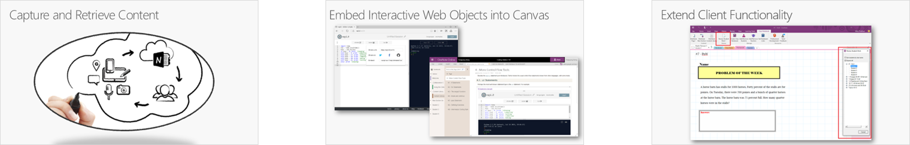
OneNote Extensibility Scenarios
Capture and Retrieve Content.
Embed interactive web objects into canvas.
Extend OneNote Client Functionality.

Slide 36
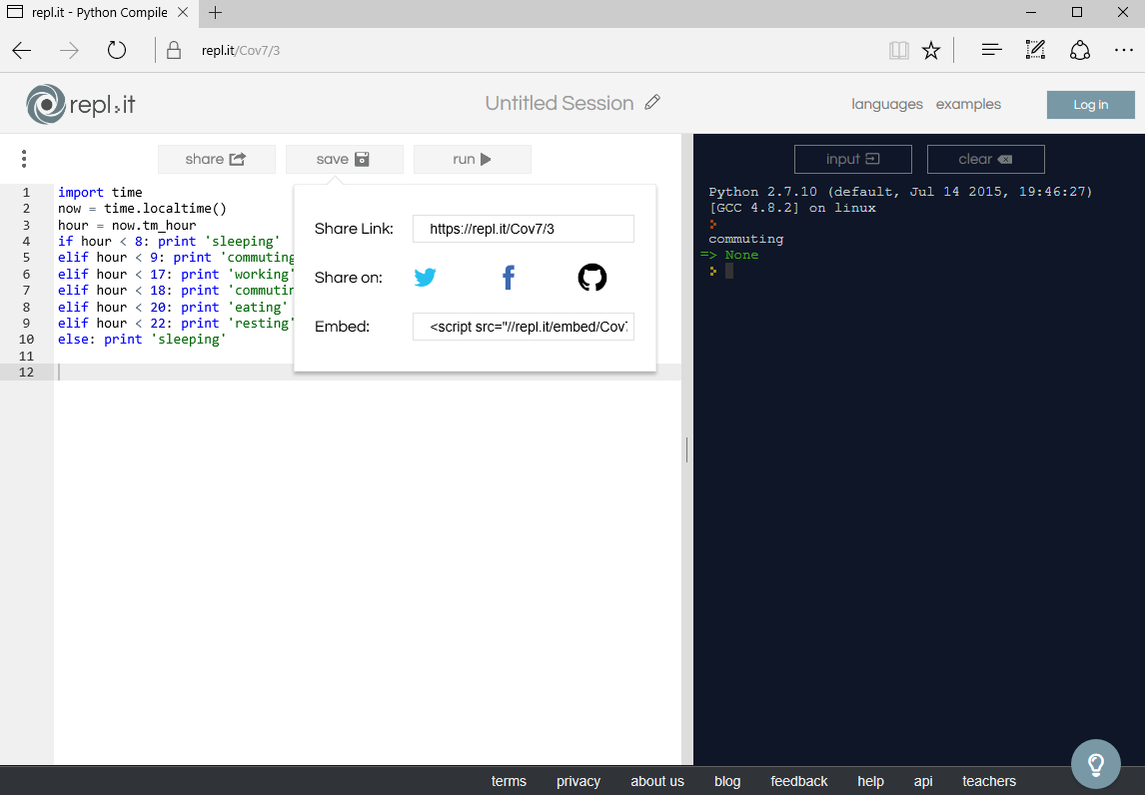
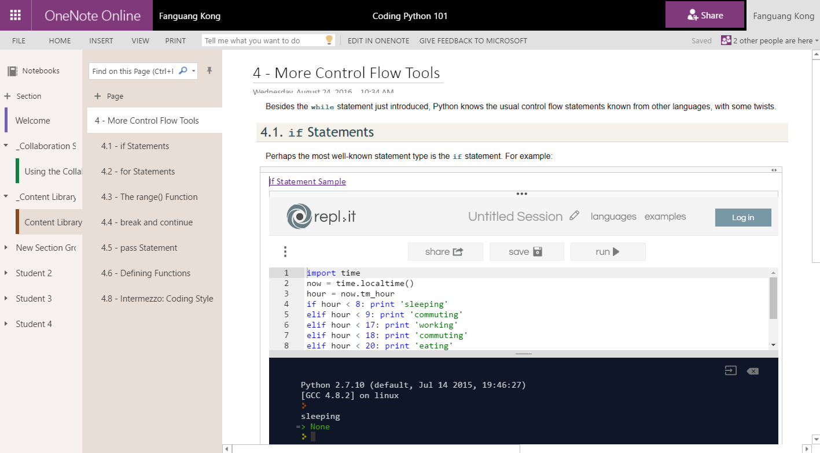
Embed Interactive Web Objects into Canvas

Slide 37
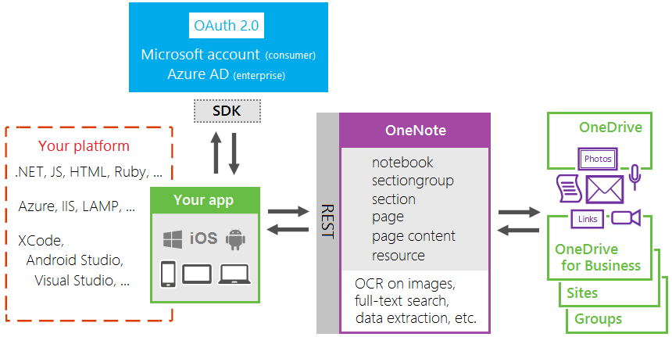
OneNote HTTP REST APIs
http://dev.onenote.com

Slide 38
Further Reading
OneNote REST API
Office Add-ins platform overview
OneNote Add-Ins Programming Overview
OneNote JavaScript API
Building Your First OneNote Add-in
Office Platform - Engage
Join the Office 365 Developer Program - http://dev.office.com
Follow us on Twitter - @OfficeDev
Provide feedback at User Voice - https://officespdev.uservoice.com
Interact on Stack Overflow - office-js, microsoftgraph, office365api, office365connectors, excel-addins, outlook-web-addins, sharepoint-api

